Slide 1
ST. CLARE COLLEGE OF CALOOCAN

Slide 2
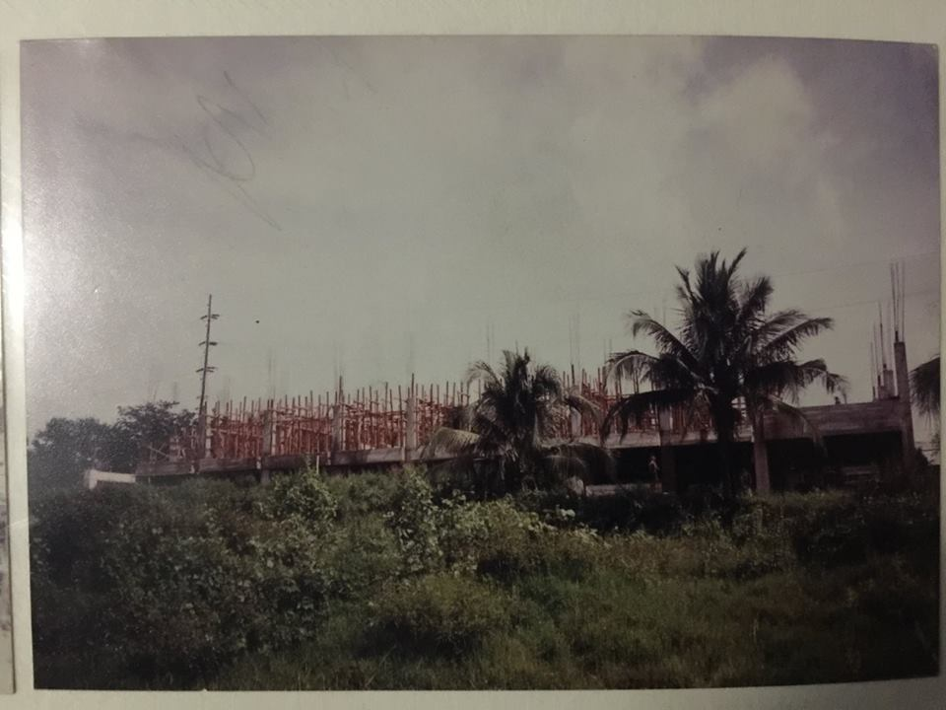
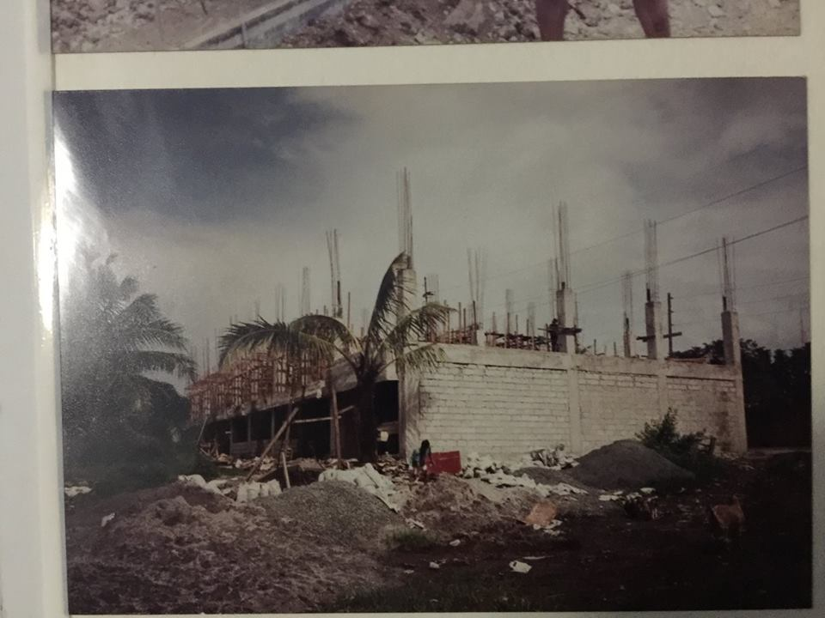
In 1986, Dr. Clarita G. Adalem, a Master Teacher in Pangasinan founded the 1st of three schools established by the Adalem Family. The Better Children of St. Clare Montessori Center in Lillesville, and in 1992, the Better Children of St. Clare Montessori Center- Sto. Niño. In 1995, the St. Clare College of Caloocan was established due to the economic crisis and resounding clamor of parents in the first district of Caloocan.

Slide 3
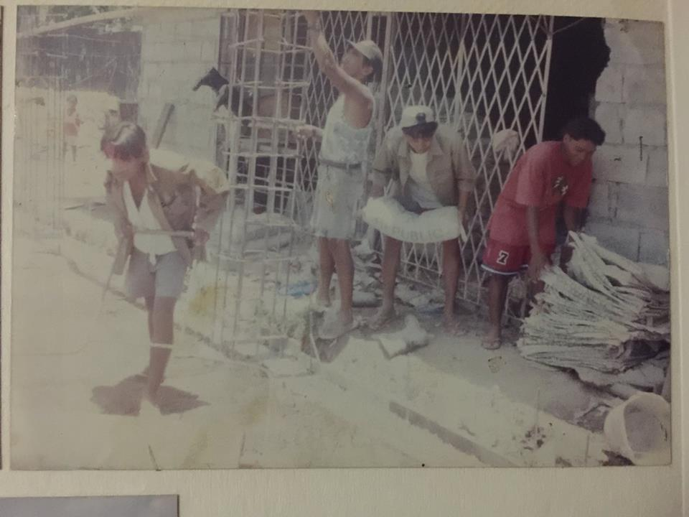
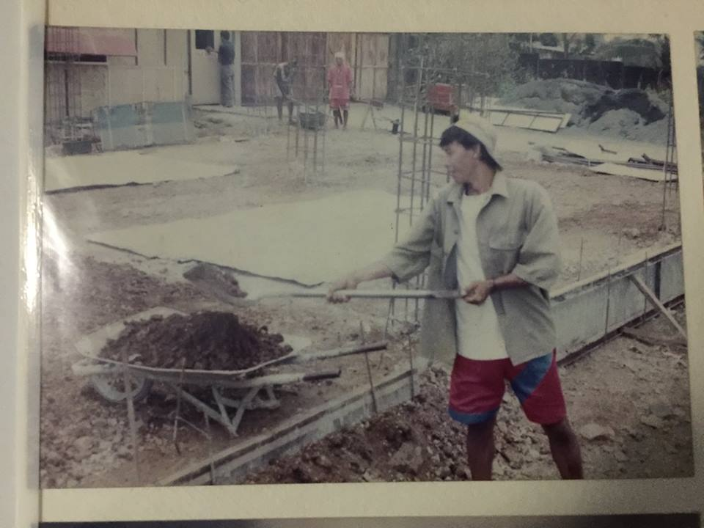

Slide 4
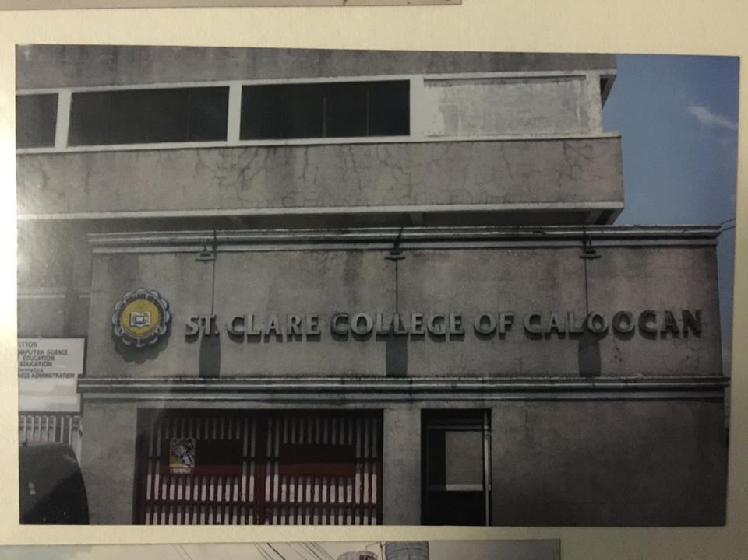
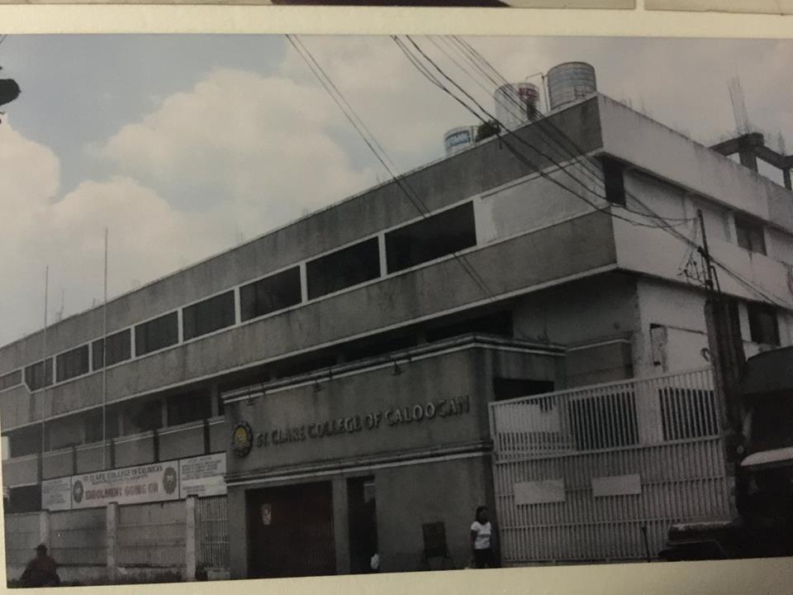

Slide 5
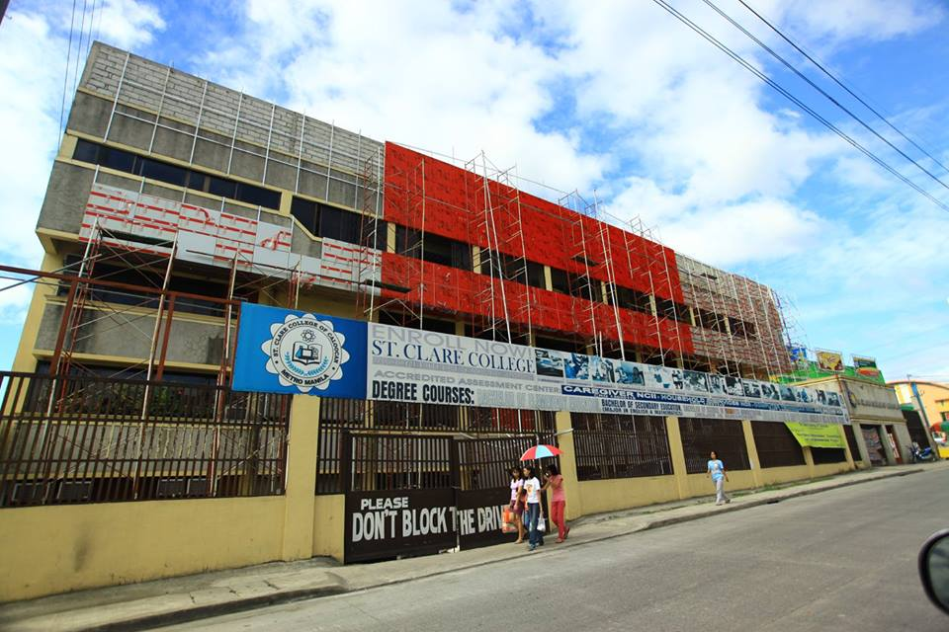
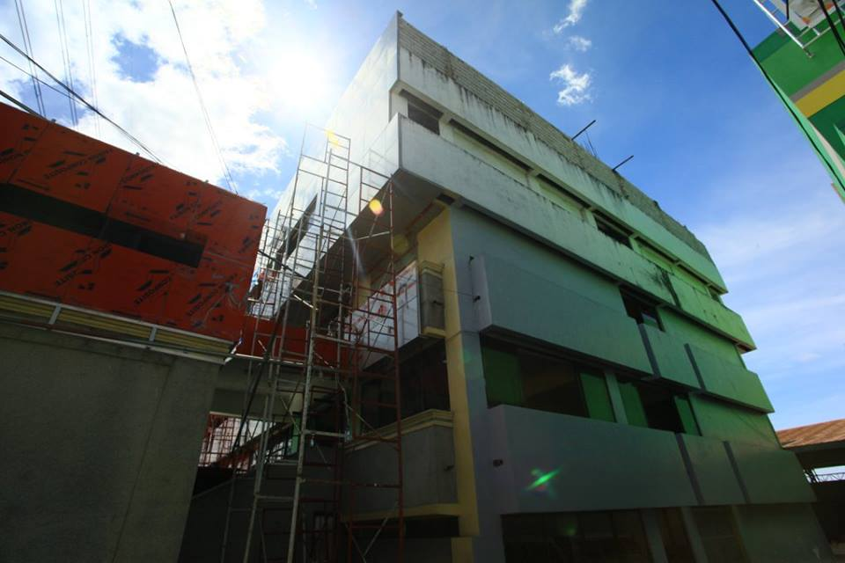

Slide 6
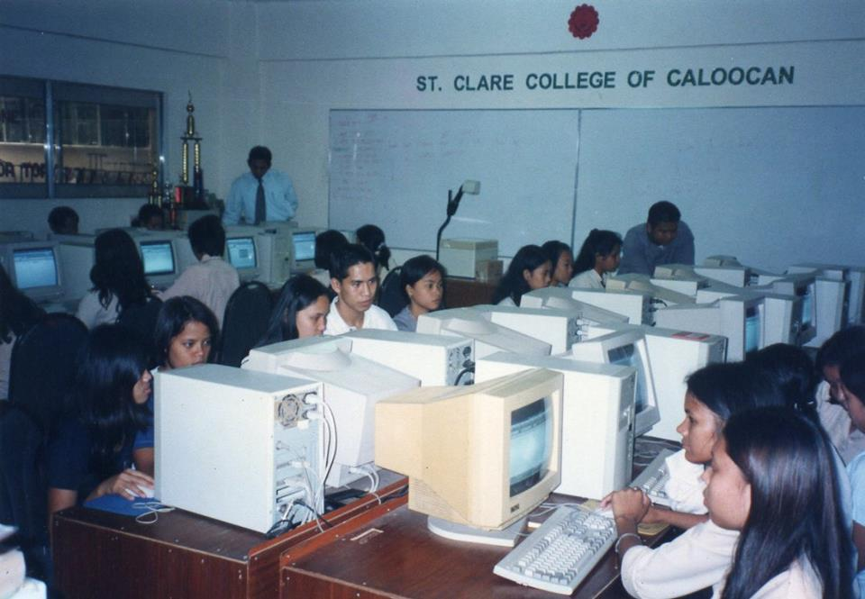

Slide 7
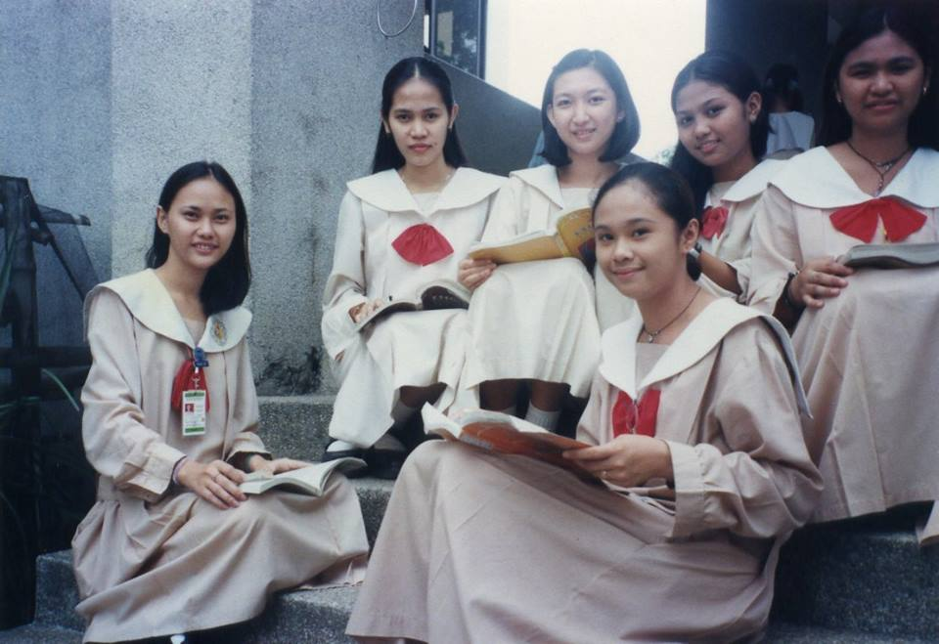

Slide 8
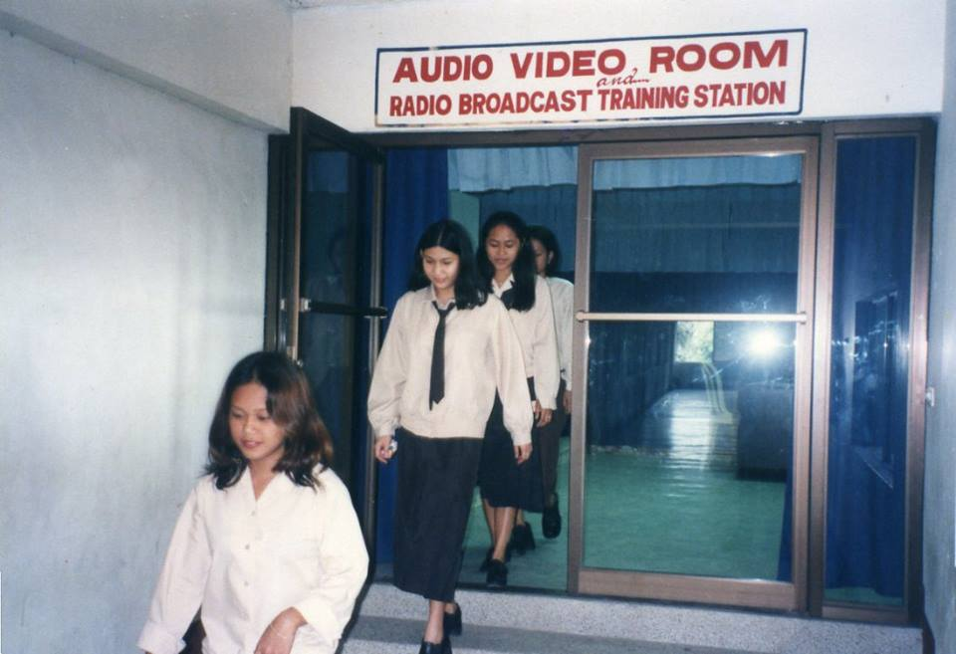

Slide 9
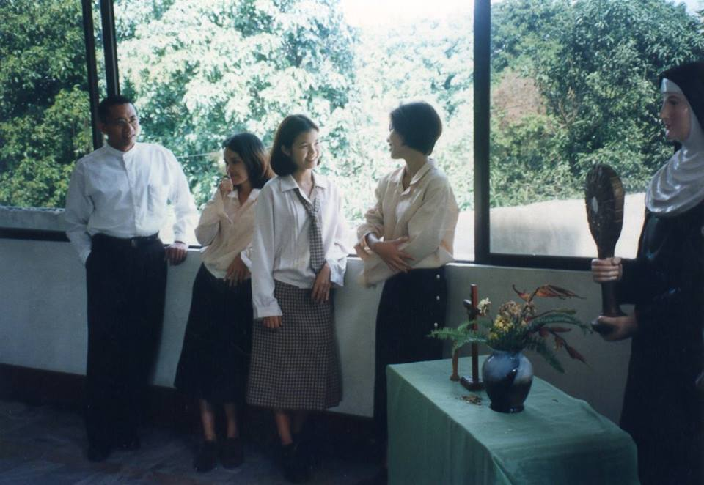

Slide 10
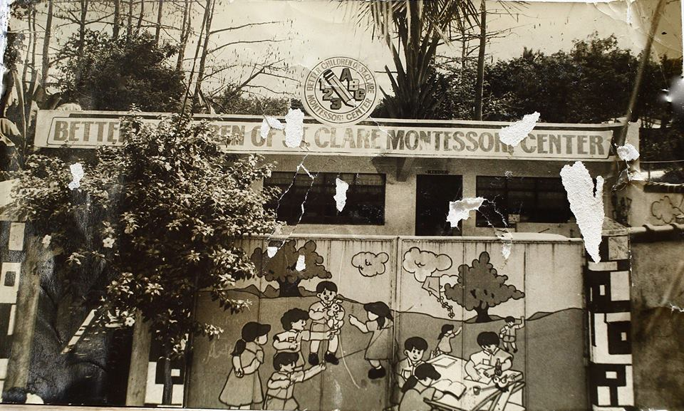
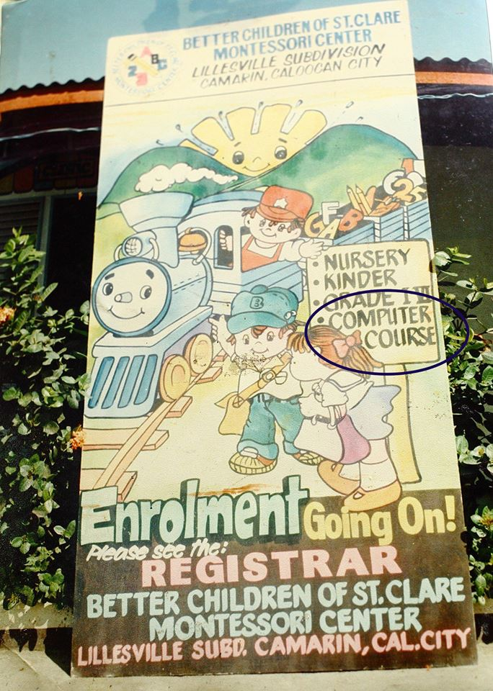

Slide 11
St. Clare College is the first HEI/HIGHER EDUCATION INSTITUTION (COLLEGE) in North Caloocan, at the time, there were no malls, banks and other buildings in the area. The founder of St. Clare Group of Schools is Dr. Clarita G. Adalem, an Alumna & National Awardee of Philippine Normal College Batch '64 (Now Philippine Normal University). The Late Chairman, Dr. Ernesto M. Adalem had a POST-DOCTORAL DEGREE in HARVARD UNIVERSITY, USA. The institution is known to many as "school of firsts" as it is the first school in 1986 to offer computer subjects in its curriculum in the pre-school & elementary levels. First school in north Caloocan to be a national champion in junior basketball championship held in Dumaguete City by then BASKETBALL ASSOCIATION OF THE PHILIPPINES (BAP). First school in Caloocan as CHAMPION of NAASCU & NCRAA, First School in Caloocan to use TABLETS & E-BOOKS, FIRST SCHOOL IN NORTH CALOOCAN TO HAVE: RADIO BROADCAST TRAINING STATION, PLDT TELEPHONE LINE, INTERNET CONNECTION (1998), TRAINING HOTEL, CAFE for BARISTA & Food & Beverage Services & The First Culinary School in Caloocan. WORLD CHAMPION in World Cycling Championship by Ryan Cayubit. First Miss NAASCU, First On-line Enrollment System, First SCHOOL WEBSITE IN NORTH CALOOCAN. The list goes on and on. Truly, St. Clare Group of Schools is pioneer in providing AFFORDABLE & QUALITY EDUCATION for the youth not only in Caloocan City but also to nearby cities, municipalities and the entire nation.

Slide 12
The school brought about accessibility and affordability school fees in the area. The unique programs enriched with advanced programs in the computer literacy brought about the unending rise of in enrollment in the two Montessori schools. This brought about the establishment of St. Clare College of Caloocan in 1995 but classes formally started in 1997.

Slide 13
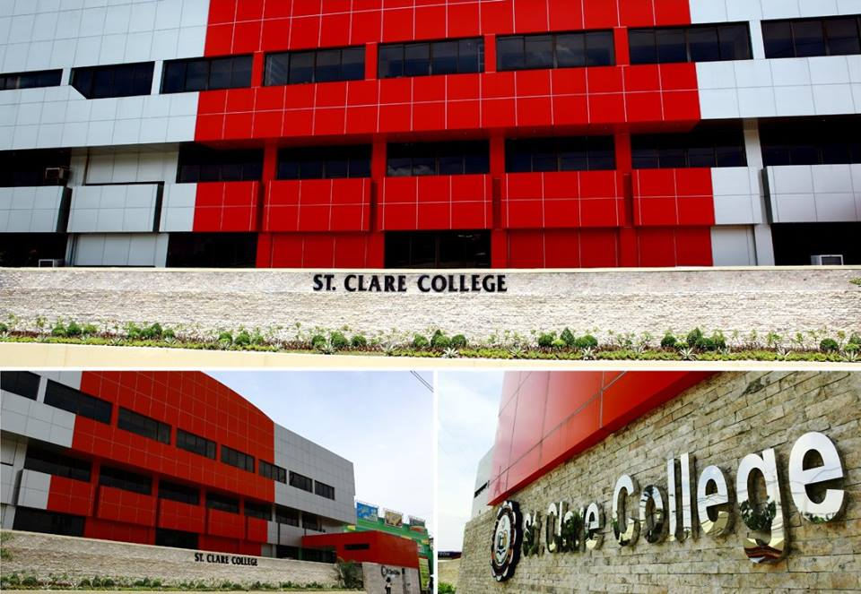
At present, the College offers Pre-school, Basic Education, Senior High school, Tertiary Education programs and TESDA Courses. There are relevant courses offered. These are BSBA, BEED, BSED English & Math, AB POLSCI, BSCS, BSHRM, BSTM.

Slide 14
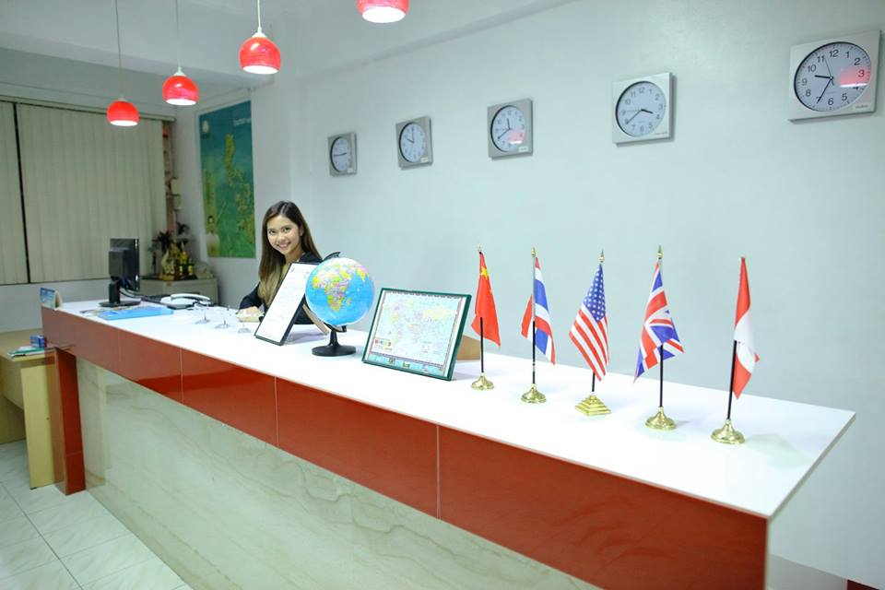


Slide 15
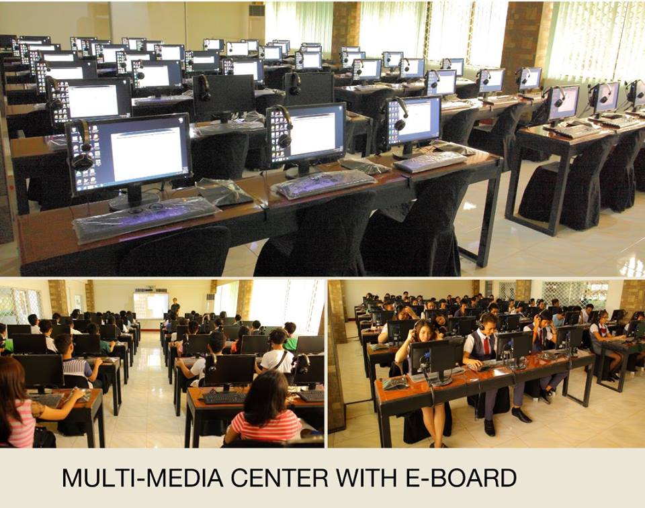

Slide 16
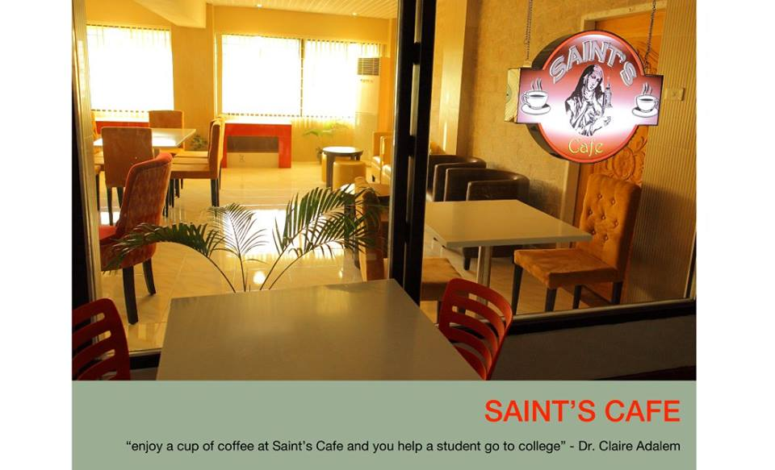
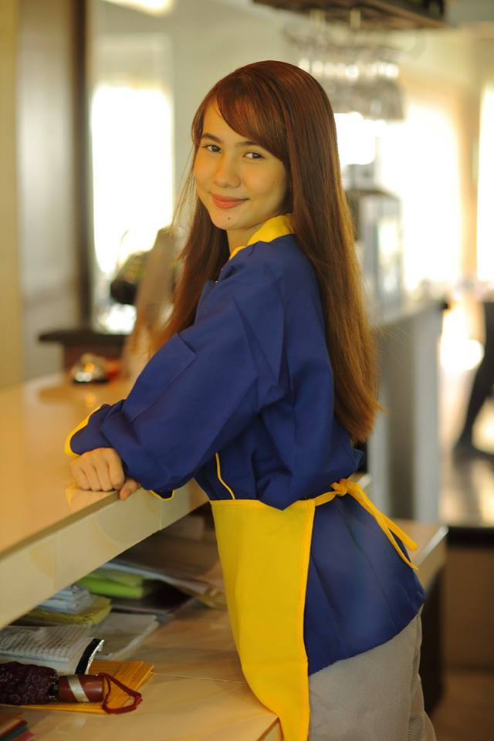
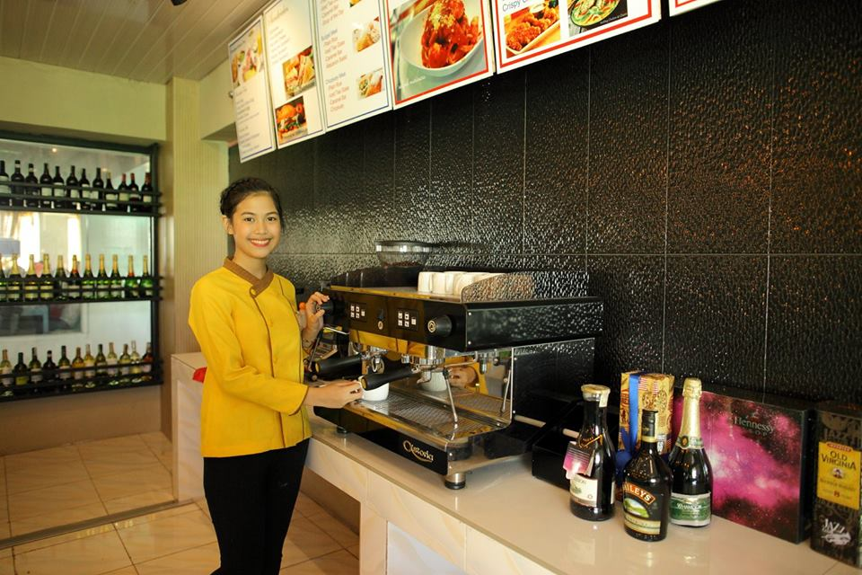

Slide 17
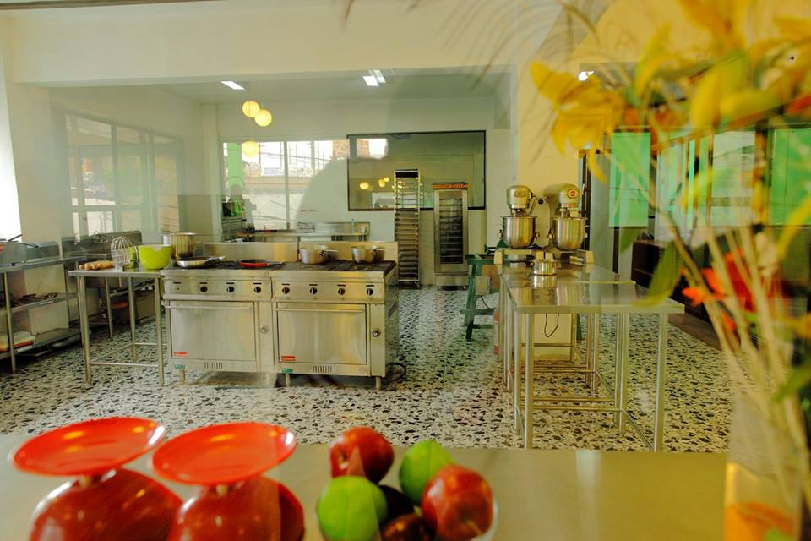
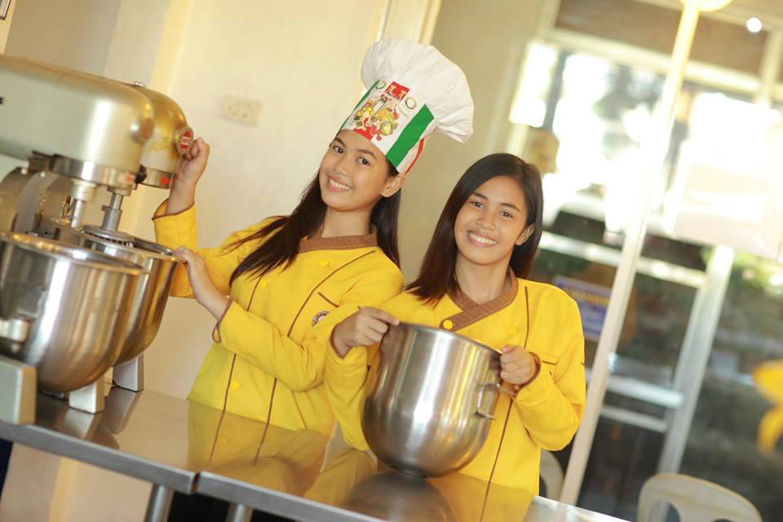


Slide 18
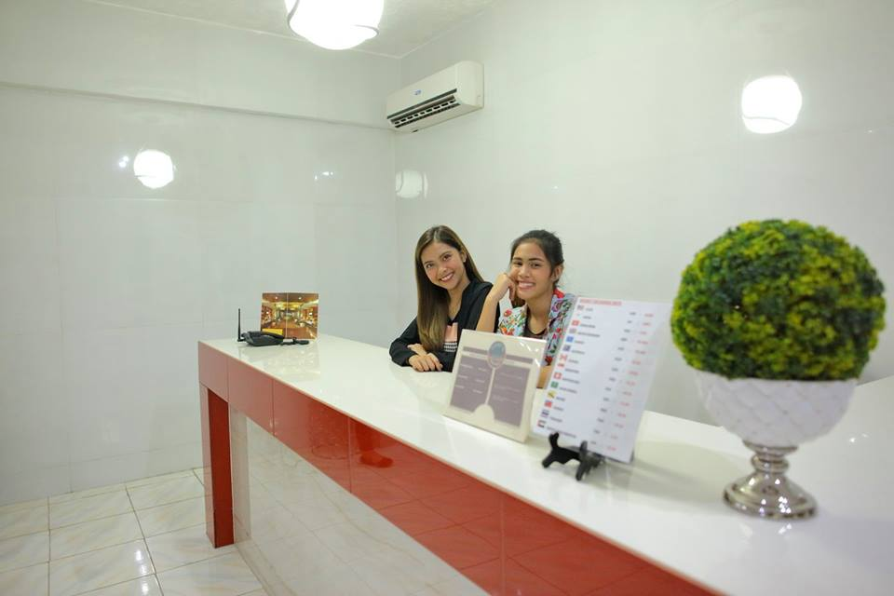
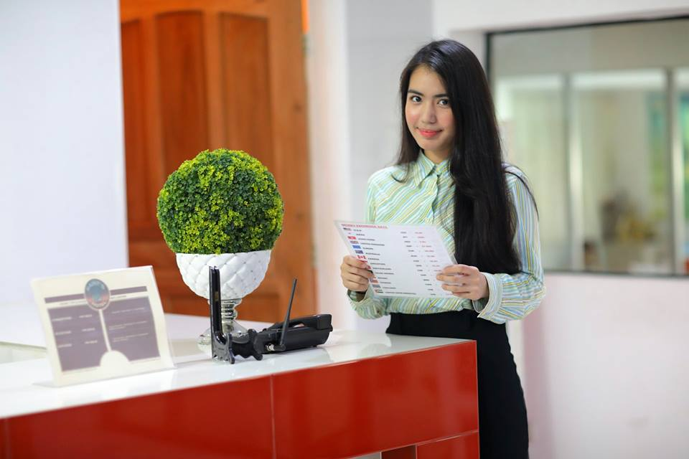


Slide 19
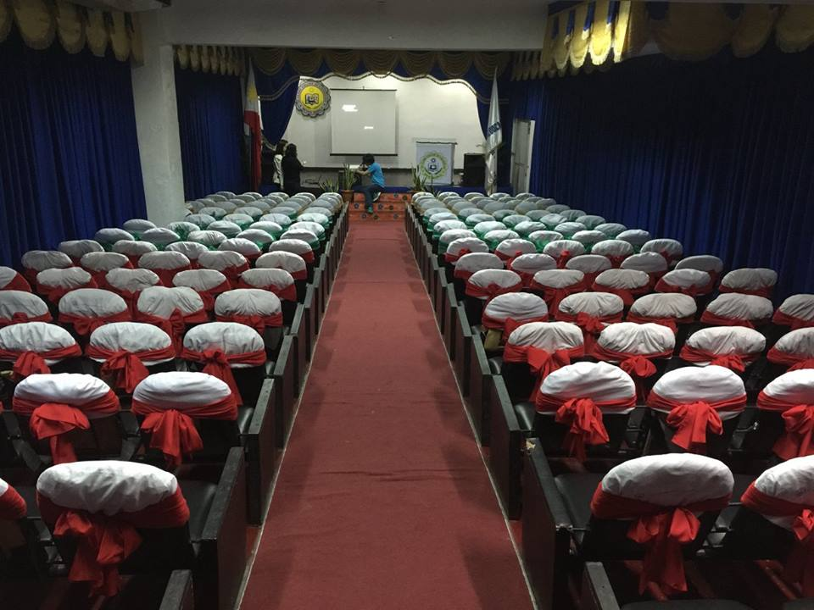

Slide 20
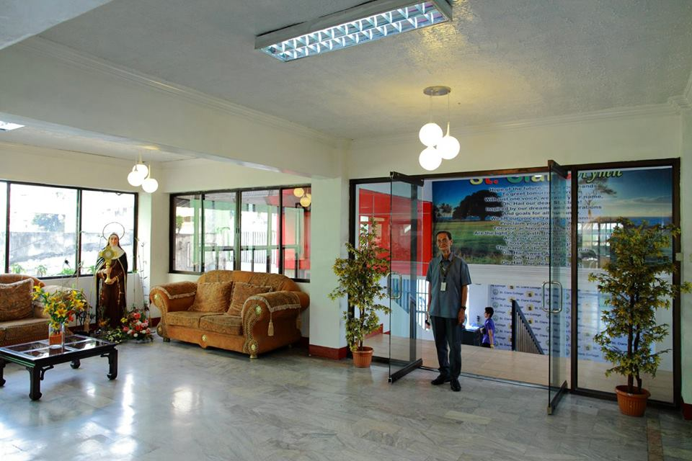

Slide 21


Slide 22
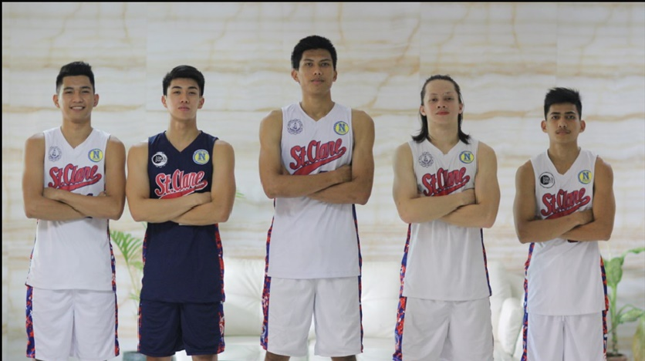

Slide 23


Slide 24
School Administration

Slide 25
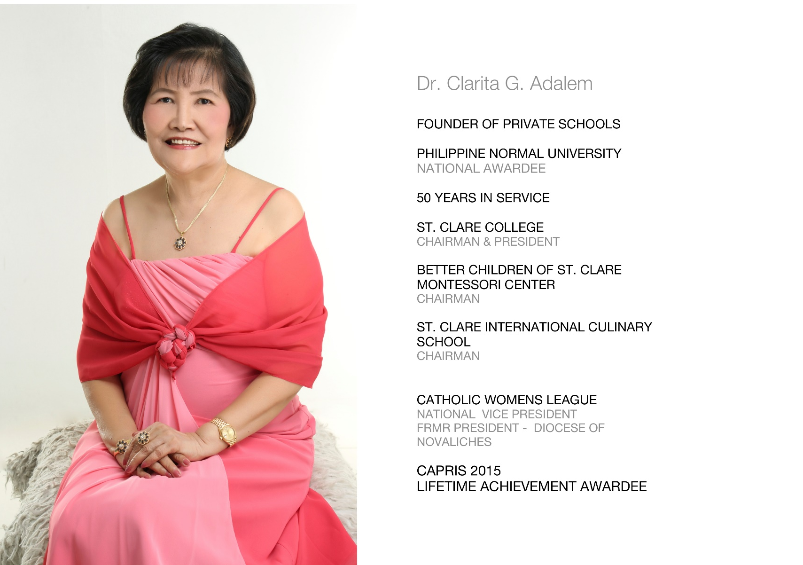

Slide 26
The founder of St. Clare Group of Schools An Academician, Dr. Clarita G. Adalem, the founder, Chairman and President of the St. Clare Group of school, effectively works with her academic constituencies to think beyond the confines of their own disciplines and areas of formal responsibilities. She contributes much in shaping broad institutional policies and successfully positioned the St. Clare Institutions to meet future challenges of change. She holds the following degrees: Doctor of Philosophy (Ph.D. Major in Science Education), Master of Arts in Education (Ma.Ed), and Bachelor of Science on Elementary Education. She has attended local and International seminars and conference, one of the most prestigious of which is the fifth UNESCO-ACEID International Conference and Reforming Curriculum and Pedagogy in Bangkok, Thailand. Her travels are not confined in Asia alone but also to the USA, Australia and Europe. In the USA, Dr. Adalem has traveled from East to the West Coast. In Europe, she has gone to France, Rome, Italy and Spain among others.

Slide 27
With regard to honors, awards and achievements, she has many academic, civic and religious awards. One of the most prestigious is the National Award given by the Philippine Normal University on May 1, 2011 for having founded private schools- the St. Clare Group of Schools. Her quest for excellence is not limited to the academe. She is actively involved in civic as well as religious organizations. She is one of the Board of Directors of the Philippine National Red Cross, Caloocan Chapter and the Vice President of the Catholic Women’s League, National Level.

Slide 28
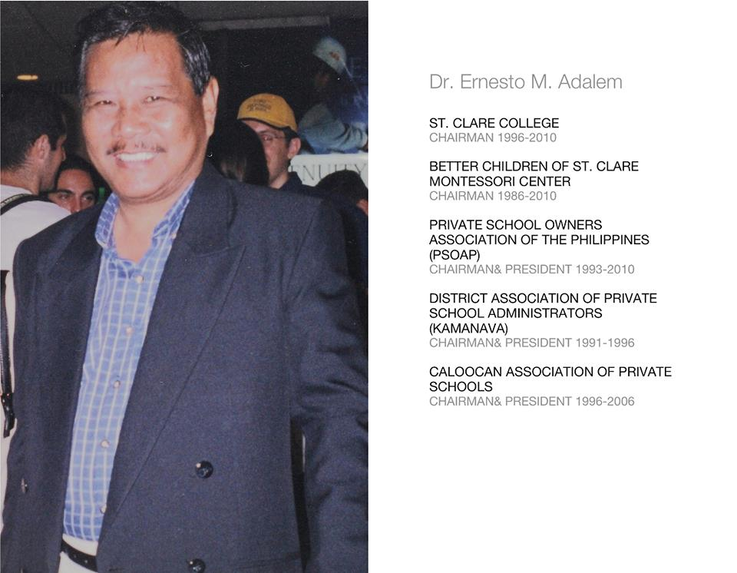

Slide 29
A strategist, President and the Chairman of the Board of Trustees of the St. Clare Group of Schools. DR. ERNESTO M. ADALEM had a powerful institutional vision who used practical and conceptual responses to the multiple responsibilities and constituencies of his role in presidency. In 2001, he was the only Filipino and one of the two Asians in a group 77 presidents of colleges and universities worldwide who were invented to the Post Doctorate Program in Institutional Advancement at Harvard University in Cambridge, Massachusetts, United States of America. Dr. Adalem had the following degrees: Post Doctorate in institutional Advancement (Harvard University, USA), Doctor of Philosophy (Ph.D.in Science Education), Master of Laws (LI.M.), Bachelor of Laws (LI.B), and B.S Agricultural Education (B.S.A. Ed). He was the President of the Private School Owners Association of the Philippines (PSOAP) and the President of the Kalookan Private School Owners Association (KAPSOA). Reforming Curriculum and Pedagogy in Bangkok, Thailand.

Slide 30
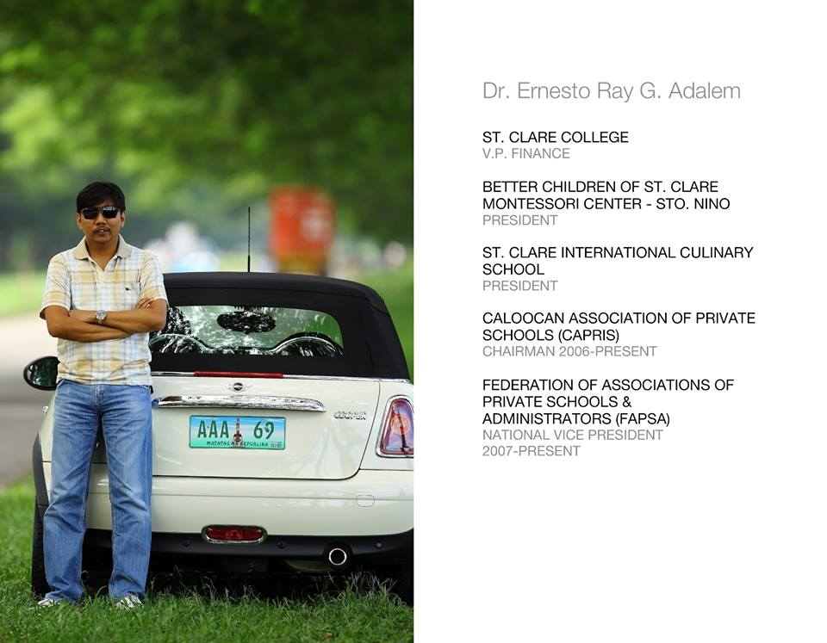

Slide 31
DR. ERNESTO RAY G. ADALEM, an effective financial analyst, conceptualized the St. Clare Scholarship program that brought about the affordability character of a quality tertiary education. The St. Clare scholarship grant is not only limited to residents of Caloocan City and neighboring NCR communities but is given to anybody who is willing to pursue a degree in the tertiary level. Dr. Ray is a Doctor of Medicine and a medical technologist. He is the Vice President for Finance and Registrar of St. Clare Group of schools. The President of Better Children of St. Clare Montessori ( Sto. Ñino) & President of St. Clare International Culinary School. He is active in various education organizations and currently the Chairman of Caloocan Association of Private schools (CAPRIS) and the National Vice President (VP-internal) of the Federation of Associations of Private Schools And Administrators (FAPSA)

Slide 32
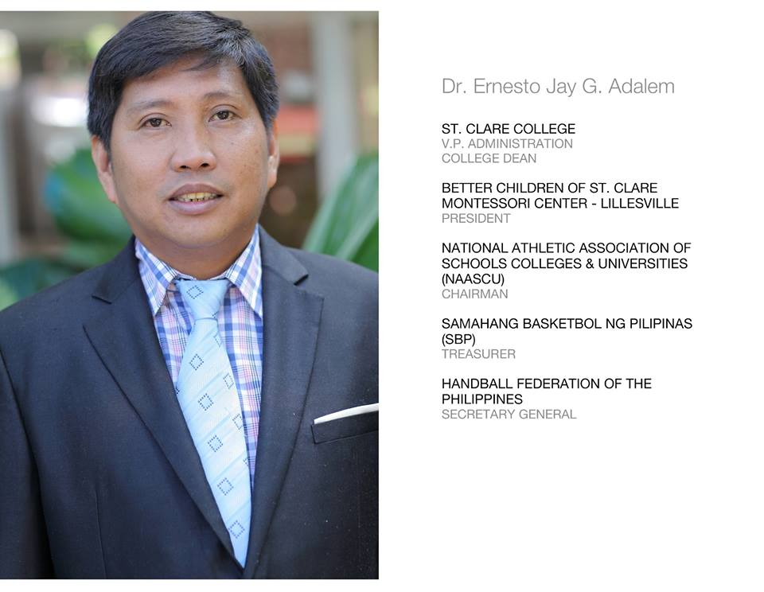

Slide 33
DR. ERNESTO JAY G. ADALEM, in the Helm of St. Clare College Sports catapulated the great name of this institution, the St. Clare Group of Schools to the National Sports Arena. Dr. Jay being the founder and President of the National Athletic Association of Schools, Colleges and Universities (NAASCU) pitted St. Clare with bigger colleges and universities of the country and amazingly came out victorious. He is a scholar of the International Olympic Committee (Olympic Solidarity Fund) in sports Management. At present, he is the National Treasurer of SBP (Samahang Basketbol ng Pilipinas) and was appointed DEPUTY CHEF DE MISSION for the Philippine Athletes is the ASIAN GAMES in South Korea. Dr. Jay is a Doctor of Medicine and Medical Technologist. He also holds a Master’s Degree in Education (MA.ED). He is the Vice President for Administration and Student Affairs of St. Clare College of Caloocan, the Director of Alumni Relations and the College Dean. Dr. Jay’s quest of knowledge is unstoppable as clearly manifested with his latest training in Sports Medicine.

Slide 34
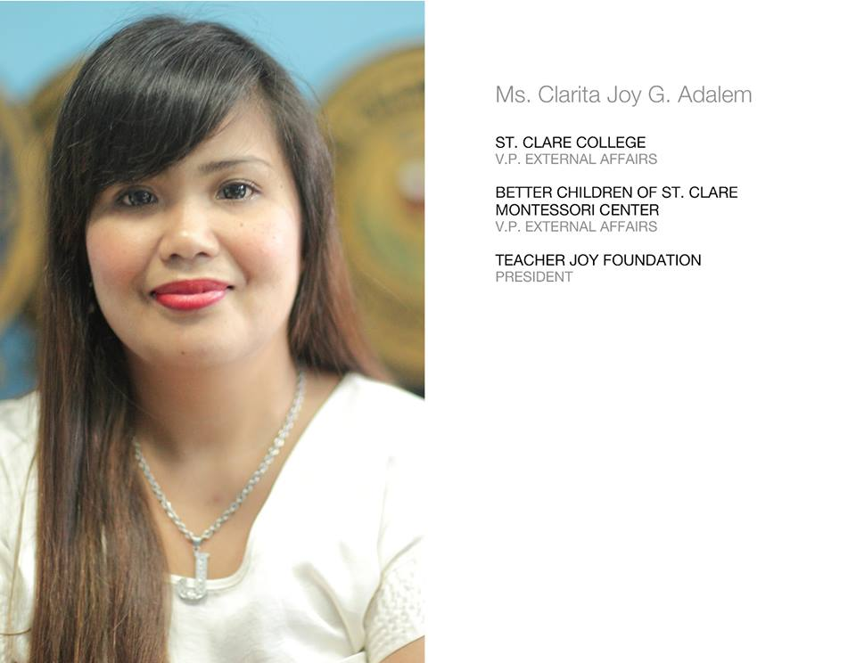

Slide 35
MS. CLARITA JOY G. ADALEM, holds multi tasks at St. Clare College of Caloocan. She is the Vice President for External Affairs. Ms. Adalem holds a Degree in Bachelor of Science in Computer Science. Despite her being a graduate of Computer Science, she has positioned herself in Business and Politics under Mayor JR Fronda of Batangas. She has a genuine interest for children and as such she is well-known as Teacher Joy. She epitomizes “Joy” with her ready smile for everybody.

Slide 36
SCHOOL POLICIES/ACADEMIC REGULATIONS (1) Students should finish the registration process to be considered officially enrolled. The complete registration process involves: a. Payment of Matriculation b. Enlistment in scheduled classes c. School Orientation and Signing of Contract d. I.D. card processing (2) A student must be officially enrolled to participate in classes, activities or take exams. For 4th year B.S.H.R.M. and B.S. Tourism students, the minimum number of units to be enrolled is 18. (3) Only students who are officially enrolled are entitled to grades at the end of the semester. (4) Regular attendance in all classes is a must. (5) Students are expected to participate all in-campus/off-campus events and field trips.

Slide 37
(6) Students with absences exceeding 20% of the total number of school days in a semester will be dropped and will receive a mark of U.W. (unauthorized withdrawal) (7) Students with valid reasons may drop a subject within the first prelim and will receive a mark of A.W. (authorized withdrawal). A written request is required subject to the approval of the Registrar. (8) A grade is based not only on major examinations, but on every field of academics: recitation, thesis, reports, quizzes and oral exams, class participation, student’s conduct, etc. (9) A student who cheats in any examination receives a grade of 5 (FAILURE) for that examination. (10) Students should ensure that they have taken and passed all required subjects towards the completion of their degrees. One-year residency enrollment is a requirement for graduation.

Slide 38
(11) For TESDA students; it is a requirement for Graduation to take NC (National Certificate) Assessment for all modules. No Assessment, No Graduation. 3 (12) To graduate on time, Students should regularly review their GRADES to ensure they do not lack any subject. (13) The student should report to the Office of the Registrar FOR EVALUATION during enrollment and must follow the correct curriculum year level. No advanced subject is allowed without the permission of the Registrar. (14) All students are required to enroll in National Service Training Program (NSTP). Attendance in all NSTP events, camping and OJT is a requirement. (15) All students are required to enroll the PRE-OJT before enrolling the OJT program.

Slide 39
(16) The Commission on Higher Education prohibits students from taking more than two units of P.E in one semester or summer session. (17) No student may receive official school documents unless all financial obligations are settled. (18) A student who withdraws voluntarily from the School is entitled to a transfer credential (HONORABLE DISMISSAL) under the following conditions: a. Dismissal is not due to disciplinary reasons. b. Clearance from all offices within the School must be secured. (19) Payment of Graduation Fee Payment of graduation fee in the amount of Php2,500.00 is required for processing of S.O. numbers, Diploma, Transcript of Records, documents and other expenses that will be used in the ceremony.

Slide 40
GENERAL REGULATIONS (1) The student’s ENROLLMENT is considered an expression of willingness to abide by all the rules and regulations in the School. Every student is committed to the observance of these rules. (2) Special School events and functions, being part of a student’s life, should be attended by all students. (3) Students, as individuals or groups, may not use the NAME and LOGO or seal of the School. This applies to all printed materials and also in the Internet. (4) No social function of the students should be held without the written approval of the School President. (5) Notices, articles and news releases concerning the School should be cleared through the Vice President for Administration before publication or posting.

Slide 41
(6) The regulations governing the payment of matriculation and other fees are issued from time to time by the FINANCE DEPARTMENT. (7) Students must pay the entire matriculation even if dropped or transferred to another school. ENROLLMENT IS A CONTRACT. (8) NO PERMIT, NO EXAM POLICY Examination Permit may be issued provided that there is a written request or promissory note with valid reason. (9) Payment of Special Exam Fee Special exam fee is collected for the payment of penalties, facilities, utilities and overtime rendered by employees. (10) Examination Booklets Examination booklets in exchange of loose Xerox copies will serve as records for filling purposes and without it there will be no basis in the computation of grades.

Slide 42
DISCIPLINE Non-compliance or violation of the following is punishable by reprimand, dropping or expulsion: 1. Students should make a positive effort to keep the campus clean and attractive, should not destroy school property or building, observe proper disposal of waste and trashes and avoid writing on walls, tables, chairs or any surface that may tend to destroy the beauty or neatness of the surface. 2.Every student should help maintain peace and order by being orderly, courteous and respectful. 3.Students are not allowed to receive visitors without the approval of the Office of Student Affairs. 4.Students are not allowed to flock on, gather or unnecessarily roam that may tend to block, hinder or interfere the free passage through gates, doors, stairways or corridors. They should always keep right when walking through the passageway. 5.Unnecessary chatting and loud laughing are not allowed.

Slide 43
6.Students must refrain from making unnecessary noise or actions that may disturb the class. 7.Students are not allowed to erase or write announcements, notices or anything on the blackboards, bulletin boards, walls, websites and social media without the permission of the school. 8.Students are not allowed to enter the faculty room and other offices without due permission. 9.It is the responsibility of students to take care of school property and to help keep the school clean. 10. Smoking is prohibited. 11. Eating and drinking are not allowed in classrooms, laboratories, audio-visual rooms, mini theater and the library. 12. All students share responsibility for the creation and maintenance of a healthy, safe and drug-free campus. 13. Inspection of Student Property The school has the right to inspect student property on campus in the presence of the student concerned. 14. Students must greet and respect not only their subject teachers but all teachers and employees including the Board of Trustees.

Slide 44
OFFENSES A student found violating any of the rules and regulations would be subjected to disciplinary action. The severity of the punishment will be commensurate to the gravity of the offense. The disciplinary action may take in form of apology, reprimand, warning, suspension, withdrawal, dropping or expulsion. 1.No-Smoking Policy R.A. 9211, which prohibits smoking in public places including schools, colleges and universities. 2.Vandalism or any form of destruction of school property. 3.Disrespect, defiance, assault or abusive behavior towards school authorities. 4.Disruption or obstruction of teaching, administrative or any school activity.

Slide 45
5.Forgery of parent’s, guardian’s, teachers, or school official’s signature. 6.Giving false information of the real nature of reports to parents or guardians. 7.Dishonest behavior during examination or tests. 8.Fabrication or submission of falsified data, information, citation, source/s, or results in an academic exercises. 9.Tampering with and/or falsifying school or public documents and/or communications, whether physical or electronic, especially those of the.

Slide 46
FINANCE AND REGISTRAR DEPARTMENT 10. Committing any form of misrepresentation. 11. Accessing, processing or distributing pornographic materials on campus, whether in physical or electronic form. 12. Engaging in or provoking, scandalous behavior on campus or during a school-sanctioned function. 13. Moral turpitude, defined as gross disregard of moral standards expected of a human being while engaging in some activity or in the commission of a violation. 14. Committing acts inside/outside the campus that affects, destroy or tarnishes the reputation or the good name of the school or its members. (Like smoking in the immediate vicinity of the school, posting nude pictures or videos in websites, malicious or indecent comments or posts in Facebook, etc.) 7 15. Gaining undue advantage over others’ personal benefits by illegitimate means. 16. Selling food inside the campus without proper permission.

Slide 47
17. Gambling on campus. 18. Bribery, or acceptance of bribe, or any act meant to give or obtain favor or advantage illegally or unfairly, whether attempted, frustrated, or consummated. 19. Illegally obtaining or gaining access to and/or using restricted school documents, facilities or equipment. 20. Acts of disrespect or discourtesy. 21. Proselytizing or promoting one’s faith by attacking or denigrating other’s religious beliefs. 22. Acts of misconduct of a sexual nature. 23. Physical assault. 24. Threatening members of the School community. 25. Disobeying school regulations on the care of the school environment. 26. Stealing and/or unauthorized possession of others’ property.

Slide 48
27. Vandalizing personal and/or ST. CLARE property on campus. 28. Instigating and/or engaging in activities resulting in damage to school property. 29. Bringing into and/or drinking alcoholic or any intoxicating beverages on campus. 30. Failing to wear the student identification card. 31. Coming into the campus under the influence of alcohol or prohibited substances, and/or acting in a disruptive way. 32. Possession, use, or distribution of dangerous drugs (according to RA 9165) or something other than its intended medical purpose. 33. Possession of deadly weapons. 34. Computer hacking. 35. Engaging in any action that might lead to loss of life or serious injury, whether intentionally or as a result of recklessness or gross negligence (tampering fire extinguishers, sitting on ledges, dropping objects from building, etc.)

Slide 49
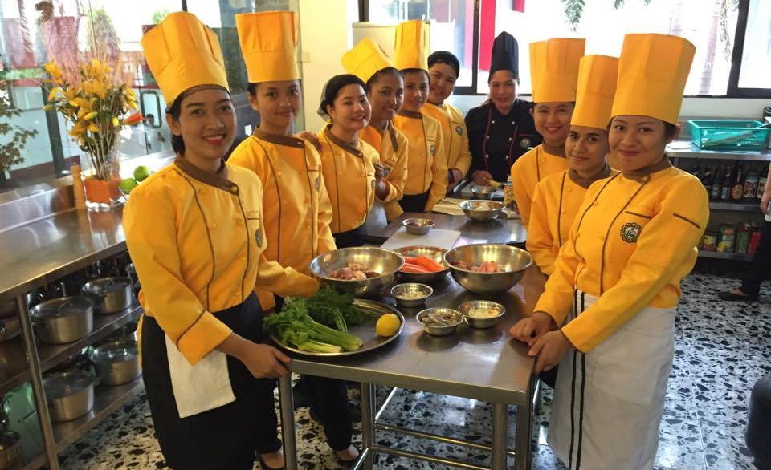
Mission To provide quality education for the development of a well-rounded individuals who’s academic excellence and dignity are beyond par.

Slide 50
Vision To become the leading school for professional development and the first and foremost provider of quality & affordable education and related services globally.

Slide 51







